Slide 1
Auto-encoders
18th May, 2018
Anshuman Pradhan

Slide 2
Agenda
Generic Neural Network
Definition of an Autoencoder
Vanilla Autoencoder
Loss functions
Denoising Autoencoders
Variational Autoencoders
Other autoencoders
Fidelity data science use-case

Slide 3

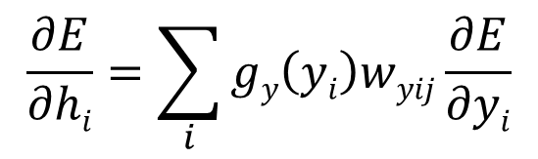




Generic Neural Network
Architecture
Feed-forward
Y
$$Y=g_{y}(W_{y}h+b_{y})$$
$$W_{y}$$
h
$$h=g_{h}(W_{I}X+b_{h})$$
$$W_{I}$$
X
Loss Calculation
Backpropagation
Compare the predicted output with the actual output (ground truth).
$E= l\left(y\right)=\sum_{k}{(\hat{y}k}−yk)$²
$$\frac{∂E}{∂hi}=\sum_{i}{gy\left(yi\right)wyij\frac{∂E}{∂yi}}$$
Should h_{i} be higher or lower
How y_{i} will change as h_{i} changes
Was y_{i} too high or too low

Slide 4
Definition of an Autoencoder
"Autoencoding" is a data compression algorithm where the compression and decompression functions are
data-specific,
lossy, and
learned automatically from examples
To build an autoencoder, we need three things:
an encoding function (a neural net),
a decoding function (also a neural net), and
a distance function between the amount of information loss between the compressed representation of your data and the decompressed representation (i.e. a "loss" function )

Slide 5
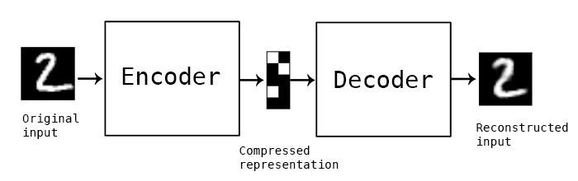
An autoencoder
Bottleneck
Input Layer
Output Layer
Latent Dimension
Hidden Layer
Hidden Layer
Example :
Notes:
Latent dimension should have less number of neurons comapred to the input space.
Output layer and the input layer have the same dimensions
Since it’s a lossy compression, you can see the difference in sharpness and brightness of the original and reconstructed image.
This difference is sometimes called the reconstruction loss.

Slide 6
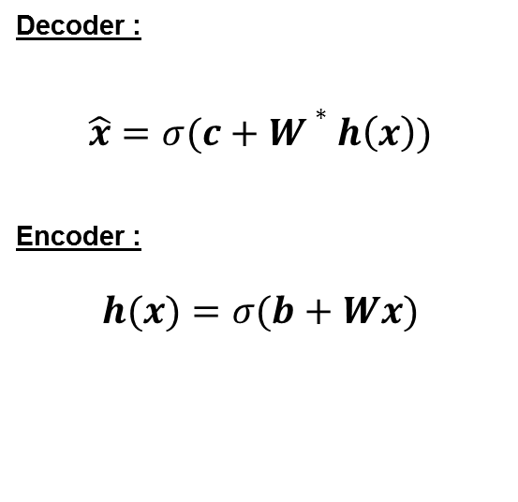
Vanilla Auto-encoder
Feed-forward neural network trained to reproduce its input at the output layer
Output layer dimension is the same as input layer dimension.
x̂
Decoder :
$$\hat{x}=σ(c+W∗h\left(x\right))$$
Encoder :
$$h(x)=σ(b+Wx)$$
W*
h(x)
W
x
Notes:
1. Sigma adds the non-linearity to the function. Here sigma is the activation function.
2. X and x-hat are in the same dimensional space.
3. Sigmoid function : 1/(1-e^{-x})
4. Alternatively we can use : tanh(x)

Slide 7
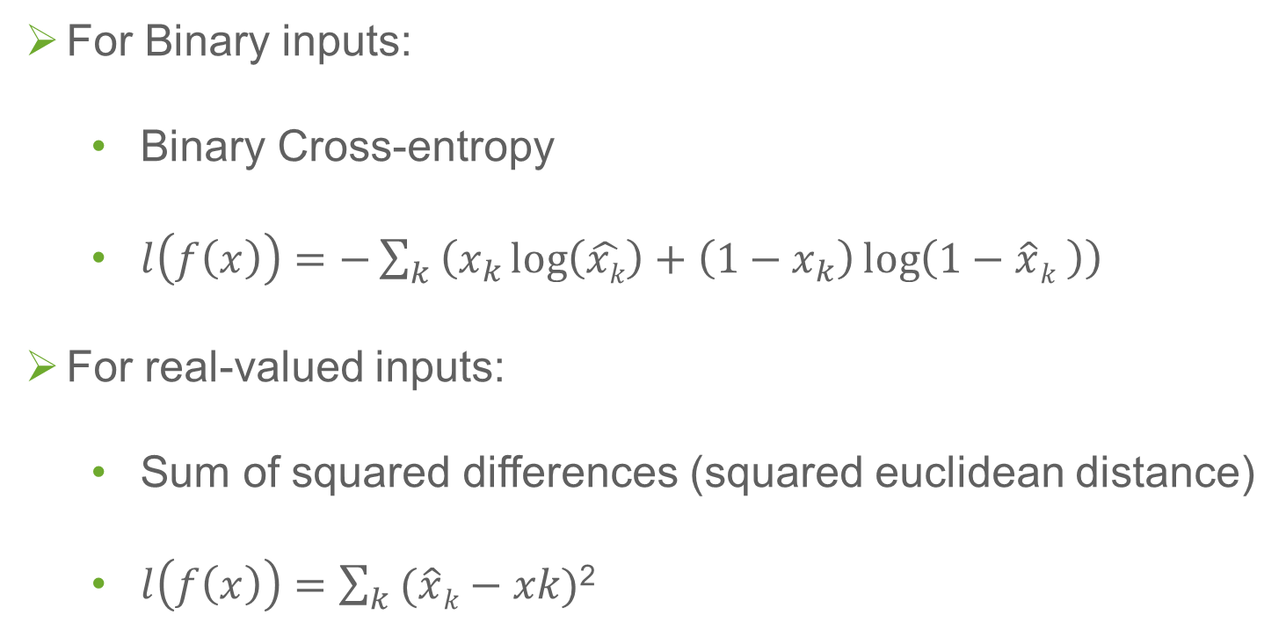
Loss Functions in Auto-encoder
For Binary inputs:
Binary Cross-entropy
$l\left(f\left(x\right)\right)=−\sum_{k}{\left(x_{k}\log\left(\hat{xk}\right)+\left(1−x_{k}\right)\log\left(1−\hat{x}k \right)\right)}$
For real-valued inputs:
Sum of squared differences (squared euclidean distance)
$l\left(f\left(x\right)\right)=\sum_{k}{(\hat{x}k}−xk)$²
Notes:
Binary cross-entropy also called Bernoulli Cross-entropy

Slide 8

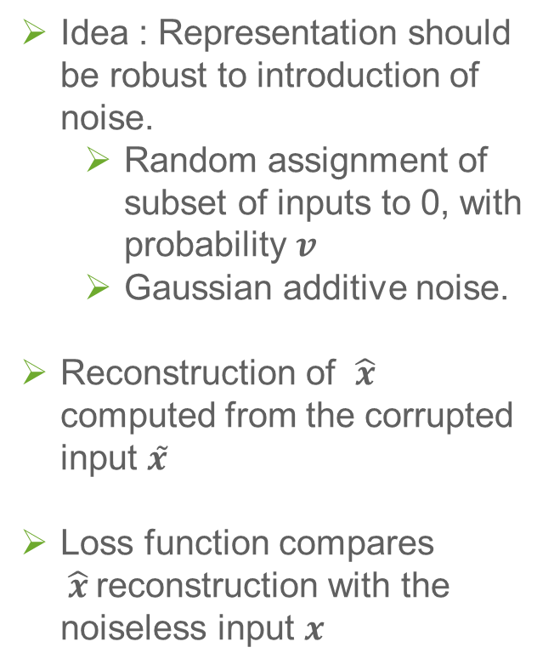



Denoising Autoencoders
Idea : Representation should be robust to introduction of noise.
Random assignment of subset of inputs to 0, with probability $v$
Gaussian additive noise.
Reconstruction of $\hat{x}$ computed from the corrupted input $x̃$
Loss function compares $\hat{x}$reconstruction with the noiseless input $x$
$$\hat{x}$$
W*
h(x)
W
$$x̃$$
0
0
Noise process
$$p(\tilde{x}|x)$$
$$x$$

Slide 9
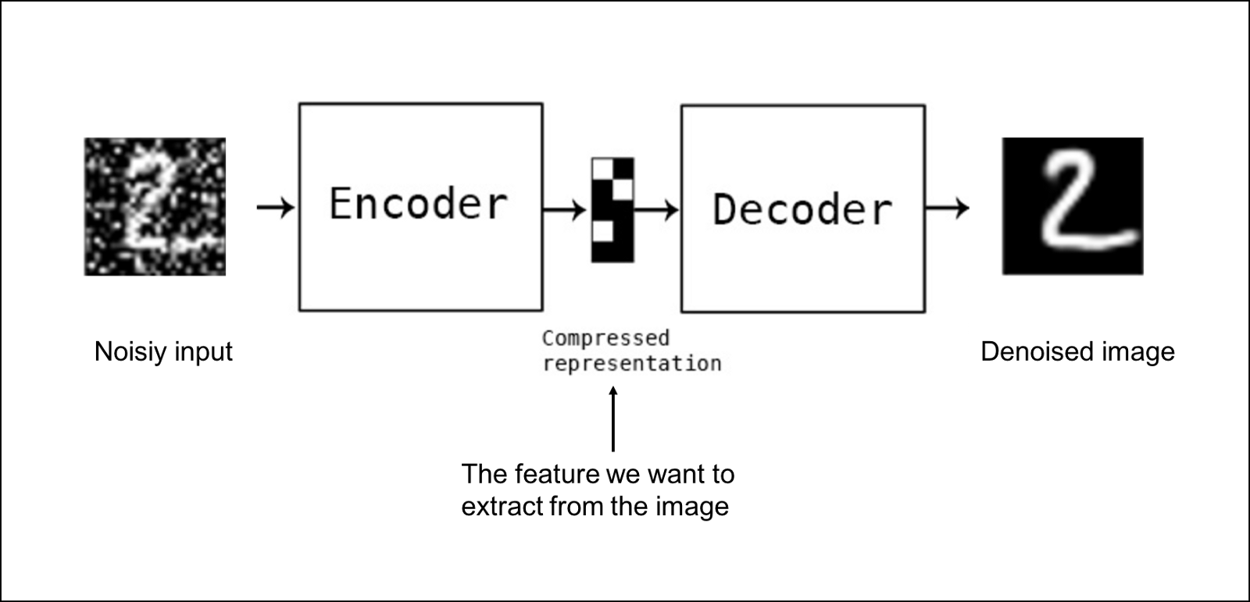
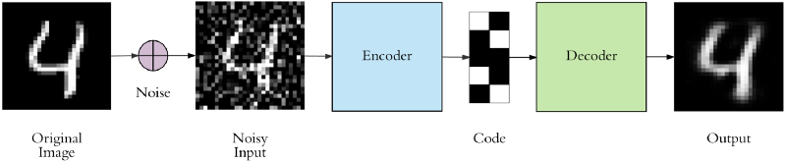
Denoising Autoencoders : Example
What we want :
How we get it :

Slide 10


Variational Autoencoders
Used as a generative model to create variations of the input.
learns a latent variable model for its input data.
Instead of learning an arbitrary function, it learns the parameters of a probability distribution modeling your data
If you sample points from this distribution, you can generate new input data samples. Thus making VAE a "generative model".
$$\hat{x}$$
Decoder
Mean Vector
Std. Dev Vector
Encoder
$$x$$

Slide 11
Variational Autoencoders : How it works
First, an encoder network turns the input samples x into two parameters in a latent space, which we will note z_mean and z_log_sigma.
Then, we randomly sample similar points z from the latent normal distribution that is assumed to generate the data, via z = z_mean + exp(z_log_sigma) * epsilon, where epsilon is a random normal tensor.
Finally, a decoder network maps these latent space points back to the original input data.
$$\hat{x}$$
Decoder
Mean Vector
Std. Dev Vector
Encoder
$$x$$

Slide 12
Variational Autoencoders : Training
The parameters of the model are trained via two loss functions:
a reconstruction loss forcing the decoded samples to match the initial inputs (just like in our previous autoencoders), and
the KL divergence between the learned latent distribution and the prior distribution, acting as a regularization term.
$$\hat{x}$$
Decoder
Mean Vector
Std. Dev Vector
Encoder
$$x$$

Slide 13
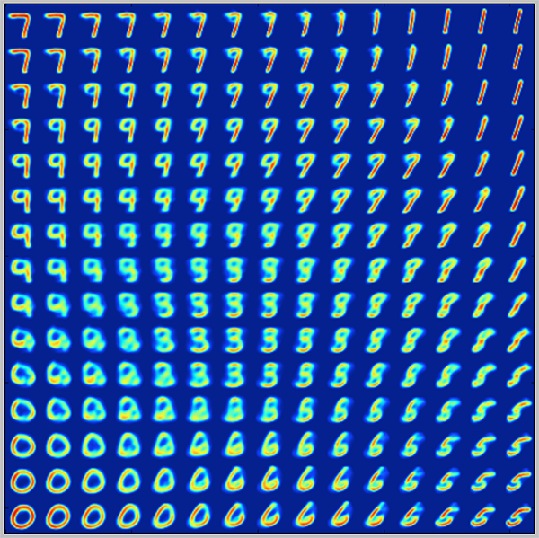
Variational Autoencoders : Example

Slide 14
Other types of Autoencoders
Contractive auto encoder (CAE)
Stacked convolutional auto encoders
Generative stochastic network (GSN)
Winner-take-all (WTA) auto encoder
Adversarial auto encoders
Sequential Autoencoders

Slide 15










Neural Network vs Recurrent Neural Network (RNN)
$$Y_{t}$$
$$Y^{(t)}=g_{y}(W_{y}h^{(t)}+b_{y})$$
Y
$$W_{y}$$
$$W_{y}$$
h
$$h_{t}$$
$$W_{R}$$
$$W_{I}$$
$$W_{I}$$
$$h^{(t)}=g_{h}(W_{I}X^{\left(t\right)}+W_{R}h^{(t−1)}+b_{h})$$
X
$$X_{t}$$

Slide 16
Sequence to sequence autoencoders (inside algorithm)
2.43 | -2.14 | 5.23 | 9.23
1.54 | 4.32 | 9.64 | 23.21
3.21 | 34.1 | 8.1 | 15.232
-2.3 | -2.43 | 12.3 | -1.23
Output
Pg1
Pg2
Pg3
Pg4
Latent Vector Repeated n-timesteps
Input
Pg1
Pg2
Pg3
Pg4
2.43 | -2.14 | 5.23 | 9.23
1.54 | 4.32 | 9.64 | 23.21
3.21 | 34.1 | 8.1 | 15.232
-2.3 | -2.43 | 12.3 | -1.23

